Slide 1

Home Appliances and Home Comfort Assignment Dream Home in Barrhaven
Student Name: Hiralben Prajapati
Course Code: GED5004
Professor name: Tim Breton
Date: 15th March 2026

Slide 2
Agenda
The appliance’s brand, model, and price
Annual energy use and operating cost
The heating, cooling and ventilation system
Reasons for HVAC choices
Installation costs of HVAC equipment
Electricity and natural gas providers and their energy rates
Conclusion

Slide 3
Part A: Complete listing of all Appliances
Refrigerator
Electric Stove
Dishwasher
Washing Machine
Dryer

Slide 4
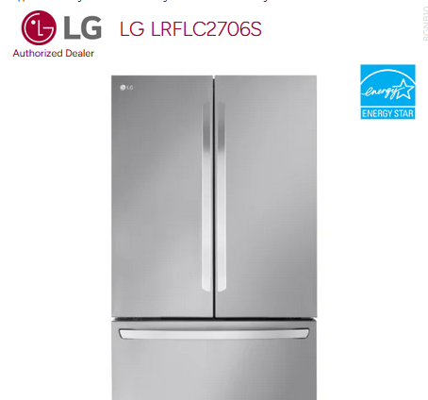
Refrigerator Canadian Appliance source. (2024).
Brand: LG
Model: LRFLC2706S
Purchase Price: $1,995
Annual Energy Use: 632 kWh/year
Estimated yearly operating cost: $76/year
Reason:
I chose this energy stat certified refrigerator because it uses less electricity compared to other models. It has a high efficiency rating, modern design, and good storage capacity.

Slide 5
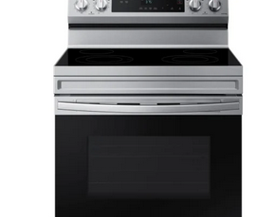
Electric Stove Canadian Appliances source. (2024).
Brand: Samsung
Model: NE63A6111SS
Purchase Price: $995
Annual energy use: 350 kWh/year
Estimated yearly operating cost: $42/ year
Reason:
This electric stove is energy efficient and has convection cooking, which reduces time and save electricity.

Slide 6
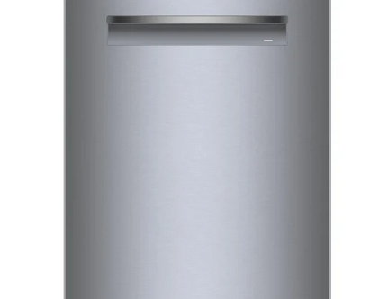
Dishwasher Canadian Appliances source. (2024).
Brand: Bosch
Model: SHP78CM5N
Purchase Price: $22,894
Annual energy use: 240 kWh/year
Estimated yearly operating cost: $28.80 per year
Reason:
This dishwasher energy star certified and energy efficient with very quiet operating cost. It has large capacity with Wi-Fi connectivity for smart control.

Slide 7
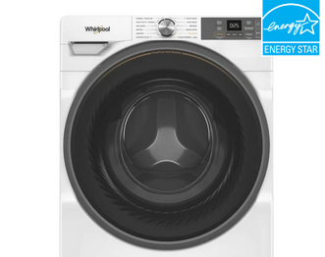
Washing Machine Canadian Appliances source. (2024).
Brand: Whirlpool
Model: WFW5720RW
Purchase Price: $1095
Annual energy use: 140 kWh/year
Estimated yearly operating cost: $17 per year
Reason:
This washing machine is energy certified, which means it uses less electricity. Steam clean and high spin speed options, which reduces the energy use.

Slide 8
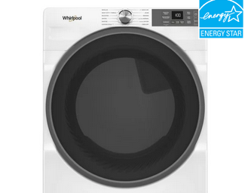
Dryer Canadian Appliance Source. (2024).
Brand: Whirlpool
Model: YWED5720RW
Purchase Price: $995
Annual energy use: 608 kWh/year
Estimated yearly operating cost: $73 per year
Reason:
This dryer is energy star certified for energy efficiency. Smart Wi-Fi features allow remote monitoring. Reliable brand with good energy performance.

Slide 9
Part B: Heating, Cooling Equipments
Water Heater
Heat Recovery Ventilator(HRV)
Heating and Cooling System

Slide 10
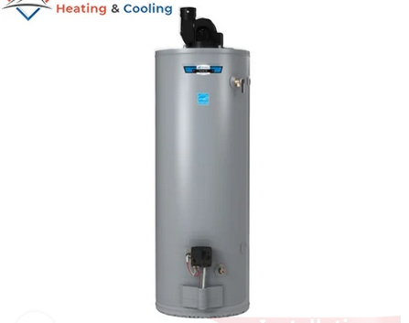
Water Heater HVAC fixed. (2024).
Brand: John Wood
Model: PV50N-40 Power Vent Tank Water Heater
Purchase Price: $2,999
Reason:
Power vent system improves energy efficiency. This water heater has 50-gallon tank capacity, which provides enough hot water for a family. Reliable Canadian brand commonly used in homes. Also, installation included in purchase price.

Slide 11
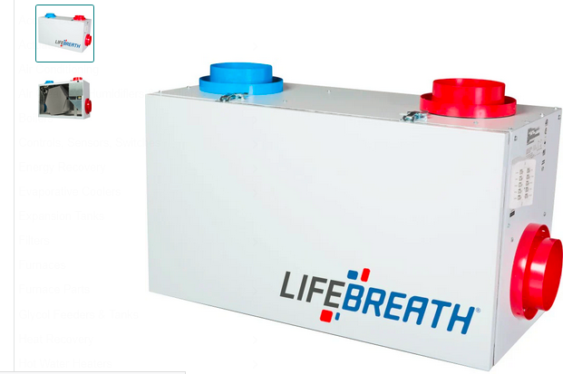
Heat Recovery Ventilator(HRV) Master Builder Mercantile. (2024).
Brand: Lifebreath
Model: 155 Max
Purchase price: $3,295
Reason:
This product provides high efficiency hex core. Energy stat certified heat recovery ventilator. A HRV improves indoor air quality while reducing heating loss.

Slide 12
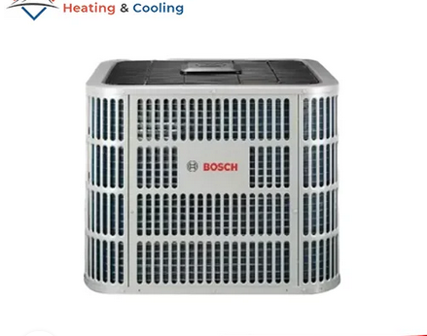
Heating and cooling system HVAC Fixed. (2024).
Brand: Bosch
Model: BOVA36
Purchase Price: $6,699
Reason:
A heat pump is environmentally friendly because it transfers heat instead of generating it. It reduces greenhouse gas emissions and lower energy usage. Energy star certified, which saves the annual energy use with 3-ton cooling capacity.

Slide 13
Part C: Energy Use
Electrical Energy Provider
Type of energy for heating and hot water

Slide 14
Electrical Energy Provider Hydro Ottawa. (n.d).
For my dream home in Barrhaven, Ontario, I decided to use electricity provided by Hydro Ottawa. This company supplies electricity to homes in the Ottawa area.
The average residential electricity cost is approximately $0.12 per kWh. This electricity will be used to operate household appliances such as refrigerator, stove, dishwasher, washing machine and dryer.
Electricity Provider: Hydro Ottawa
Energy cost: approximately $0.12 per kWh

Slide 15
Energy for Home Heating and Hot Water Enbridge Gas. (n.d.).
For heating and hot water in my home, I chose natural gas because it is commonly used in Ontario homes and is usually more affordable than electric heating.
The natural gas for home will be supplied by Enbridge Gas, which is the main natural gas provider in Ontario.
The average cost of natural gas is about $0.40 per cubic meter.
The natural gas will be used for the furnace heating system and the hot water heater in my home.
Energy Type: Natural Gas
Provider: Enbridge Gas
Energy cost: approximately $0.40 per cubic meter

Slide 16
Conclusion
I chose energy-efficient appliances and HVAC systems for my dream home in Barrhaven, Ontario. I focused on products that use less energy and are better for the environment. I also selected suitable energy providers for electricity and natural gas. This project helped me understand how choosing efficient appliances and systems can you reduce energy use and make a home more environmentally friendly.

Slide 17
References
Canadian Appliance source. (2024). LG LRFLC2706S French door refrigerator.
https://www.canadianappliance.ca/product/LG_LRFLC2706S_French_Door_Refrigerator_LG_LRFLC2706S.html
Canadian Appliances source. (2024). Samsung NE63A6511SS electric range.
https://www.canadianappliance.ca/product/Samsung_NE63A6511SS_Electric_Range_Samsung_NE63A6511SS.html
Canadian Appliances source. (2024). Bosch SHP78CM5N dishwasher
https://www.canadianappliance.ca/product/Bosch_SHP78CM5N_Dishwasher_Bosch_SHP78CM5N.html
Canadian Appliances source. (2024). Whirlpool WFW5720RW front load washer.
https://www.canadianappliance.ca/product/Whirlpool_WFW5720RW_Front_Load_Washer_Whirlpool_WFW5720RW.html
Canadian Appliance Source. (2024). Whirlpool YWED5720RW electric dryer.
https://www.canadianappliance.ca/product/Whirlpool_YWED5720RW_Electric_Dryer_Whirlpool_YWED5720RW.html

Slide 18
HVAC fixed. (2024). John Wood tank water heater 50 gallon power vent model PV50N-40.
https://hvacfixed.ca/product/john-wood-tank-water-heater-50-gallon-power-vent-model-pv50n-40/
Master Builder Mercantile. (2024). Lifebreath RNC155 residential heat recovery ventilator (HRV).
https://masterbuildermercantile.ca/products/lifebreath-rnc155-residential-heat-recovery-ventilator-hrv-132cfm
HVAC Fixed. (2024). Bosch central heat pump 36000 BTU SEER 20.5 model BOVA36.
https://hvacfixed.ca/product/bosch-central-heat-pump-36000-btu-seer-20-5-model-bova36/
Natural Resources Canada. (2024). ENERGY STAR certified products.
https://natural-resources.canada.ca/energy-efficiency/energy-star/products
Hydro Ottawa. (n.d).
https://hydroottawa.com/en
Enbridge Gas. (n.d.). My account – eBill.
https://www.enbridgegas.com/ontario/my-account/ebill

Slide 19

Thank you

